Slide 1



Project G Dept.of C
Department of Computer Science Engineering-Data Science
A Mini-Project Presentation on
“Digital Health Record Management System for migrant workers ”
RANJITA M | 3BR23CD074
S CHINNI RENUKA | 3BR23CD078
S GAYATHRI | 3BR23CD080
TARUNASHREE | 3BR23CD082
Presented by
Under the Guidance of
Mrs .V P Anushya Project Guide Dept.of CSE-DS
Dr. Jagadish R.M Project Coordinator Dept. Of CSE-DS
Dr. Aradhana D
Head of the Department
Dept. of CSE-DS

Slide 2
Contents: 1.Abstract 2.Objectives 3.Literature Survey 4.Problem Statement 5.Scope of the Project 6.Software and Hardware Requirements 7.Functional and Non-Functional Requirements 8.Description of Modules 9.Design 10.Implementation 11.Testing
12.Result 13.Conclusion 14.References

Slide 3
Abstract
The Digital Health Record Management System for Migrant Workers is designed to create a centralized and accessible platform for storing, managing, and retrieving the medical records of migrant workers. By digitizing health records, quick access to medical data for both patients and healthcare providers, and secure data storage using authentication mechanisms. The system integrates modules for registration, record management, and hospital access, making it easier to update and share medical information efficiently.

Slide 4
Objectives
To develop a secure and centralized digital platform for storing and managing
migrant workers’ health records.
To enable quick access and real-time updating of medical information by both healthcare providers and workers.
To ensure data privacy, authentication, and easy retrieval of health history across different locations.
To support continuous healthcare and better medical decision-making through organized digital records.

Slide 5
Literature Survey
S. No. | Author / Year | Title / Source | Key Findings / Contributions | Relevance to Project
1. | Saleh S. et al., 2020 | Sijilli: A Cloud- Based Electronic Health Record for Refugees | Proposed a portable and secure EHR platform using cloud storage and QR access for displaced populations. | Demonstrates feasibility of cloud-based health records for mobile populations like migrant workers
2. | Ndlovu K. et al., 2021 | Interoperability Challenges in Linking mHealth Apps to the Record Systems | Highlighted technical issues in connecting mobile apps with hospital EHRs using HL7/FHIR Standards. | Helps designdatasharing features and integration between migrant health apps and hospitals.
3. | Tensen P. et al., 2024 | Electronic Personal Health Records for Mobile Populations – Feasibility Study | Found user trust, language, and connectivity as key adoption challenges for digital health tools. | Guides user interface design and offline accessibility for migrant worker systems.

Slide 6
Problem Statement
Digital Health Record Management System for migrant workers aligned with sustainable development goals.

Slide 7
Scope of the Project
Provides a centralized digital platform for storing migrant workers’ health records.
Enables easy access to medical history for doctors and workers.
Ensures timely medical interventions through notifications and reminders.
Can be extended for mobile access, government portal integration, and health analytics.

Slide 8
Software/Hardware requirements
Software Requirements:
Operating System: Windows 11
Frontend: React (with JavaScript), HTML
Backend: Node JavaScript
Database: MySQL
Development Tools: VS Code ,Command prompt
Other Tools: Browser (Chrome/Edge), ER Diagram tool (Lucidchart)

Slide 9
Hardware Requirements
Processor: Intel i3 or above
RAM: Minimum 4 GB (8 GB recommended)
Storage: Minimum 100 GB Hard Disk
Display: 1024x768 resolution or higher
Network: Internet connection for online record access and storage

Slide 10
Functional and Non-functional requirements
Functional Requirements
1.User Registration and Authentication:
Migrant workers, doctors, and administrators should be able to register and log in securely.
2.Health Record Management:
Allows healthcare staff to create, update, and retrieve patient (migrant worker) medical records.
3. Doctor Access and Consultation:
Doctors can view a worker’s medical history and update diagnoses, prescriptions, or test results.

Slide 11
Non-functional requirements
1. Security:
All sensitive health data must be encrypted and accessible only to authorized users.
2. Usability:
Interface should be user-friendly and accessible even for low-literate users.
3. Scalability:
Should handle large numbers of migrant workers across different regions.
4. Performance:
System must retrieve health records within 2–3 seconds.

Slide 12
Description of Modules
1. User (Migrant Worker) Module:
Enables workers to register, view their personal details, and access their health history.
2. Doctor Module:
Doctors can view medical history, add prescriptions, lab results, and recommendations.
3. Health Record Module:
Stores all patient medical data — including allergies, previous treatments, vaccinations, and medical reports.

Slide 13
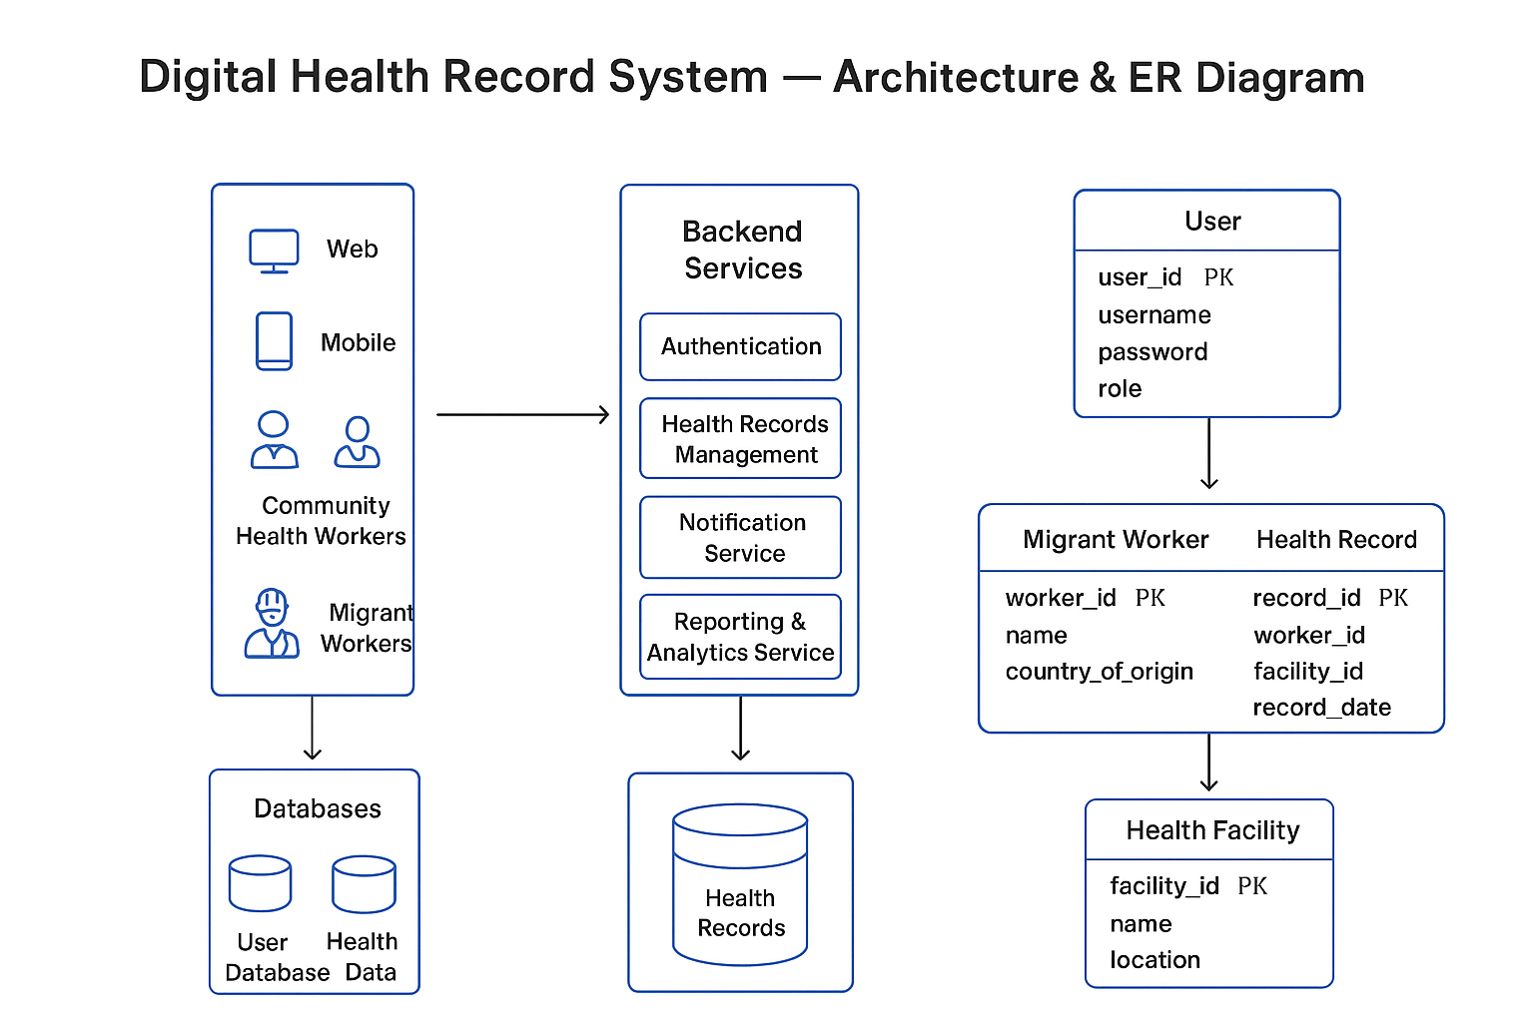
DESIGN:

Slide 14
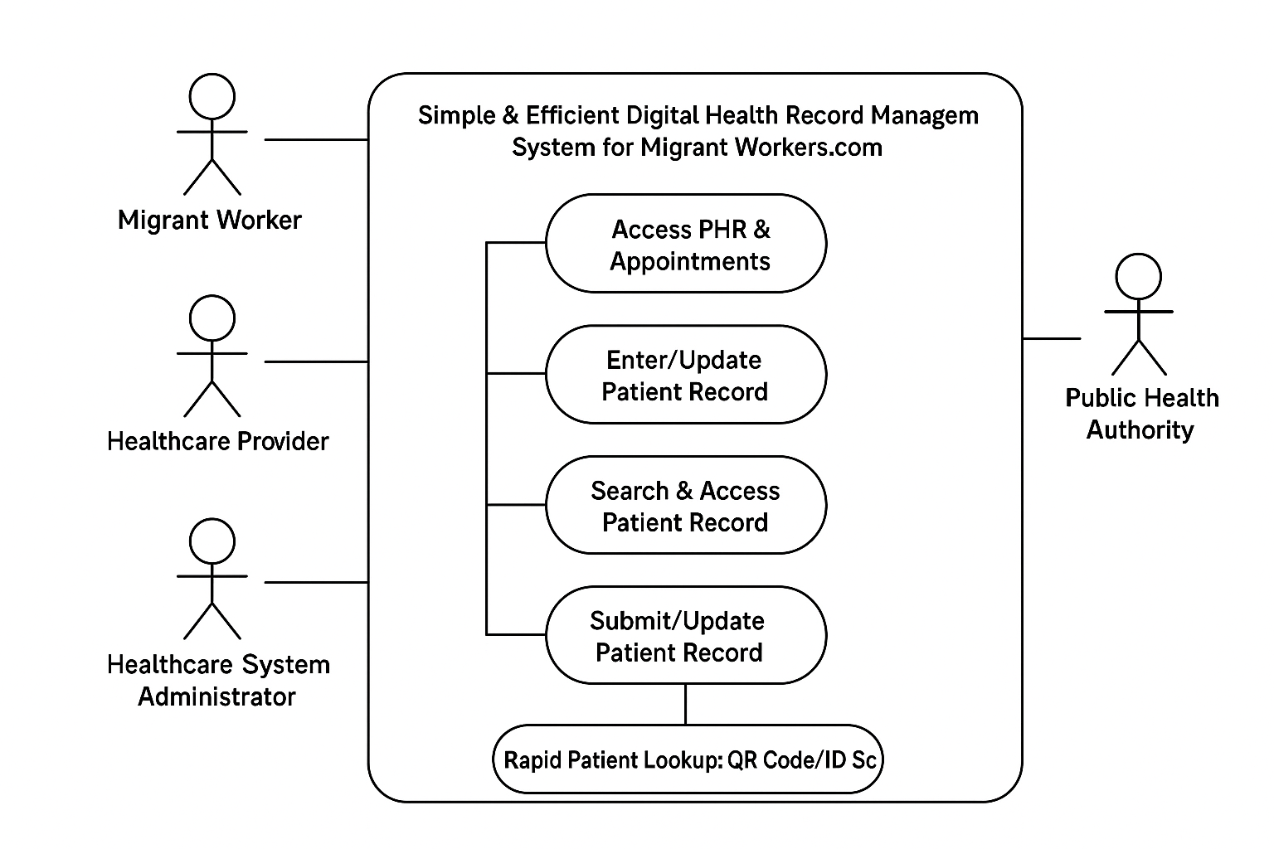
Use case diagram

Slide 15
Implementation
The project follows a clean folder structure where all main logic, components, and styles are kept inside the src folder.
We implemented the project using React with TypeScript, building the entire user interface using .
A main HTML file is used as the entry point where the React app gets loaded.
We used Vite for fast development and optimized builds through its configuration file.
CSS is integrated to style the website using utility classes for a modern, responsive UI.
Several JSON configuration files (package.json, tsconfig.json, etc.) are used to manage dependencies, scripts, and TypeScript settings.
A Netlify deployment configuration is included for easy hosting and continuous deployment.

Slide 16
Testing
Functional Testing: All core features (forms, buttons, navigation, user actions) were tested to ensure they work correctly in the browser.
Component Testing: Individual React components were checked to ensure proper rendering and expected behavior.
Responsive Testing: The UI was tested across multiple screen sizes (mobile, tablet, desktop) to confirm Tailwind-based responsiveness.
Browser Compatibility Testing: The application was tested on major browsers like Chrome, Edge, and Firefox to ensure consistent performance and layout.
Build Testing: A production build was generated using Vite (npm run build) to verify that the project compiles without errors.
Deployment Testing: After deploying to Netlify, the live site was tested to ensure pages load correctly and all features function as expected.

Slide 17
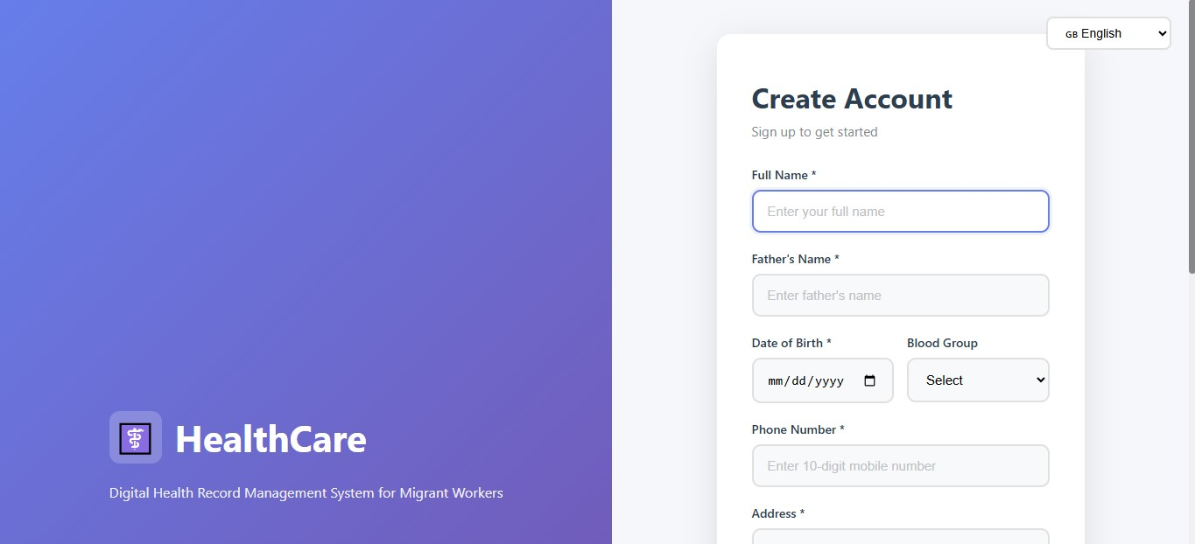
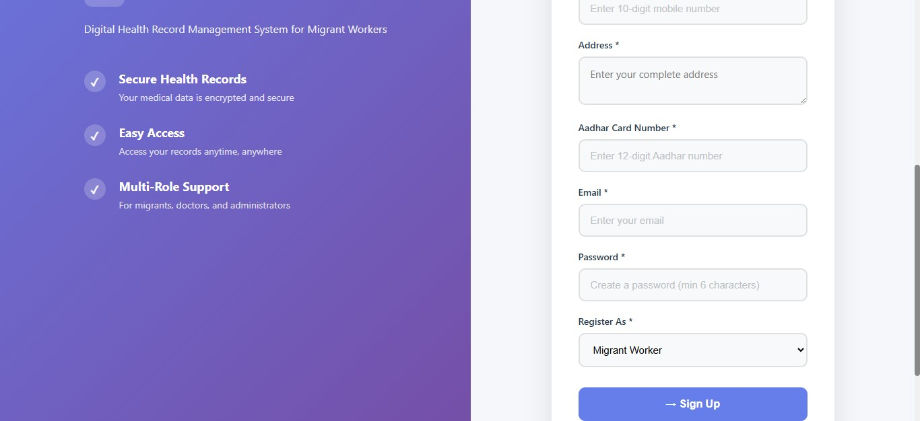
Result
Sign-up/sign-in-page
The image shows a web based portal page for a migrant health with fields or username or passwords.

Slide 18
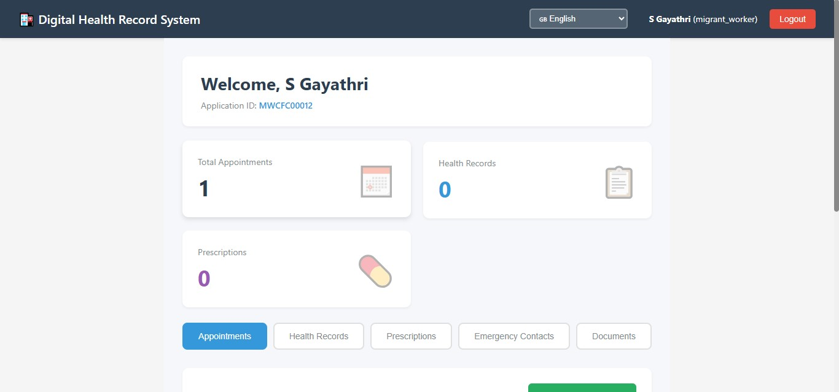

Slide 19
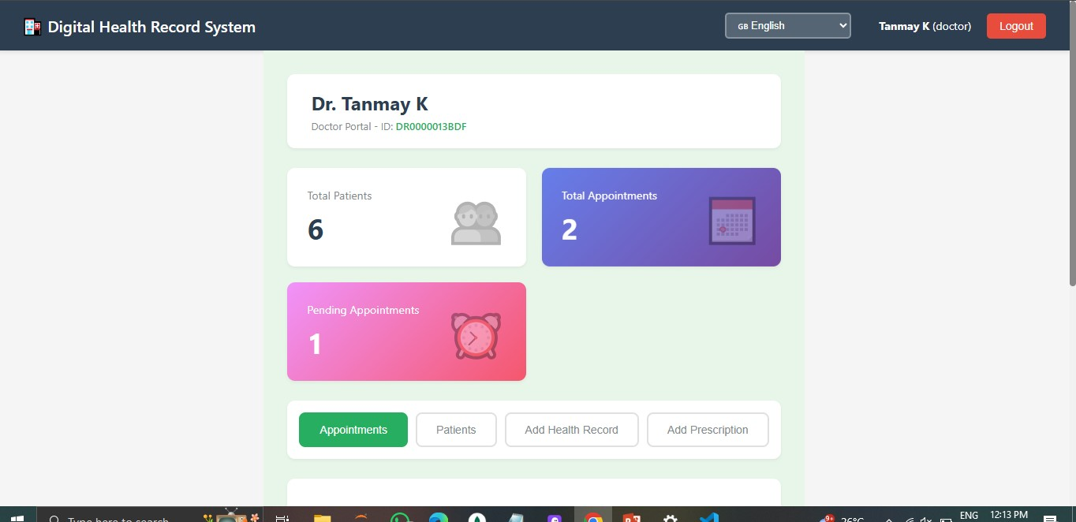

Slide 20
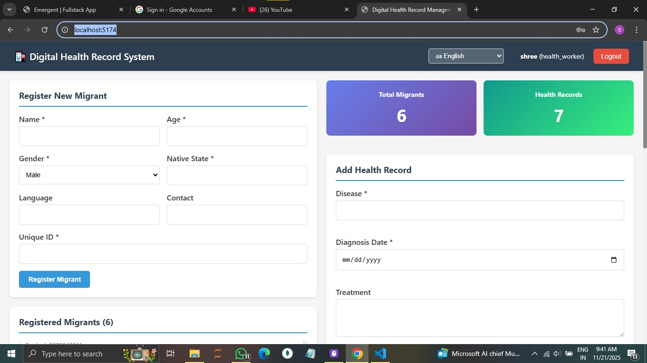

Slide 21
References
World Health Organization (WHO). (2021). Global strategy on digital health 2020–2025. → https://www.who.int/publications/i/item/9789240020924
United Nations. (2015). Transforming our world: The 2030 Agenda for Sustainable Development. → https://sdgs.un.org/2030agenda
HL7 International. (2024). FHIR (Fast Healthcare Interoperability Resources) Specification. → https://hl7.org/fhir/
Ministry of Health and Family Welfare, Government of India. (2022). National Digital Health Mission (NDHM) Blueprint. → https://ndhm.gov.in/

Slide 22
Conclusion:
The Digital Health Record Management System greatly improves the daily lives of migrant workers by making their health information easily accessible, secure, and portable. It ensures quick medical care, reduces repeated tests, and helps doctors provide better treatment anywhere. Aligned with SDG goals, it promotes good health, equality, and sustainable communities by connecting people, clinics, and health services seamlessly.

Slide 23
THANK YOU

